Slide 1
Analytic Techniques to visuaize censored content (Sina weibo)
Avidan Rothman & (Advisor) Dr. Leberknight

Slide 2
TABLE OF CONTENTS
01
02
03
OnLine Censorship
Project FOcus
Dataset description
How does Censorship affect cybersecurity
Natural Language Processing (NLP) Analytic Techniques
Collection of data

Slide 3
TABLE OF CONTENTS
04
05
06
Software development Tools
Demo
Q&A
Streamlit vs Django or Flask

Slide 4
Online Censorship in Cybersecurity
Misinformation dilemma- Social Media’s part in spreading misinformation
Prevention of information sharing and isolation of individuals
How can this research be used in cybersecurity?

Slide 5
Project focus
Parts of Speech (POS)
Word Embedding
LDA Topic analysis
Analyzing parts of speech to determine frequency of used words to determine patterns or trends
Vector representations of specific words. Objective is to have words with similar context to maintain close special positions.
Topic model used to identify words and apply a common topic

Slide 6
Dataset Description
Dataset content | Dataset columns | Data origination
80,000+ Rows | Weibo IDs | FreeWeibo.com
 | Usernames
 | Time Created/Time scraped

Slide 7
Data cleansing process
Before we could begin to use the dataset, we needed to be sure that the data was clean. We needed to account for the following types of “dead data”.
NULL
Empty cells
Illegible characters (Ex. Strings of !!! or ???)
Duplicate data
Why is this important?
Notes:
The reason this is important is because in order to have an accurate dataset we must remove data that could skew the results and possibly give false results. The other reason is that with these lines of “Bad Data” it could break the code itself creating further challenges.

Slide 8
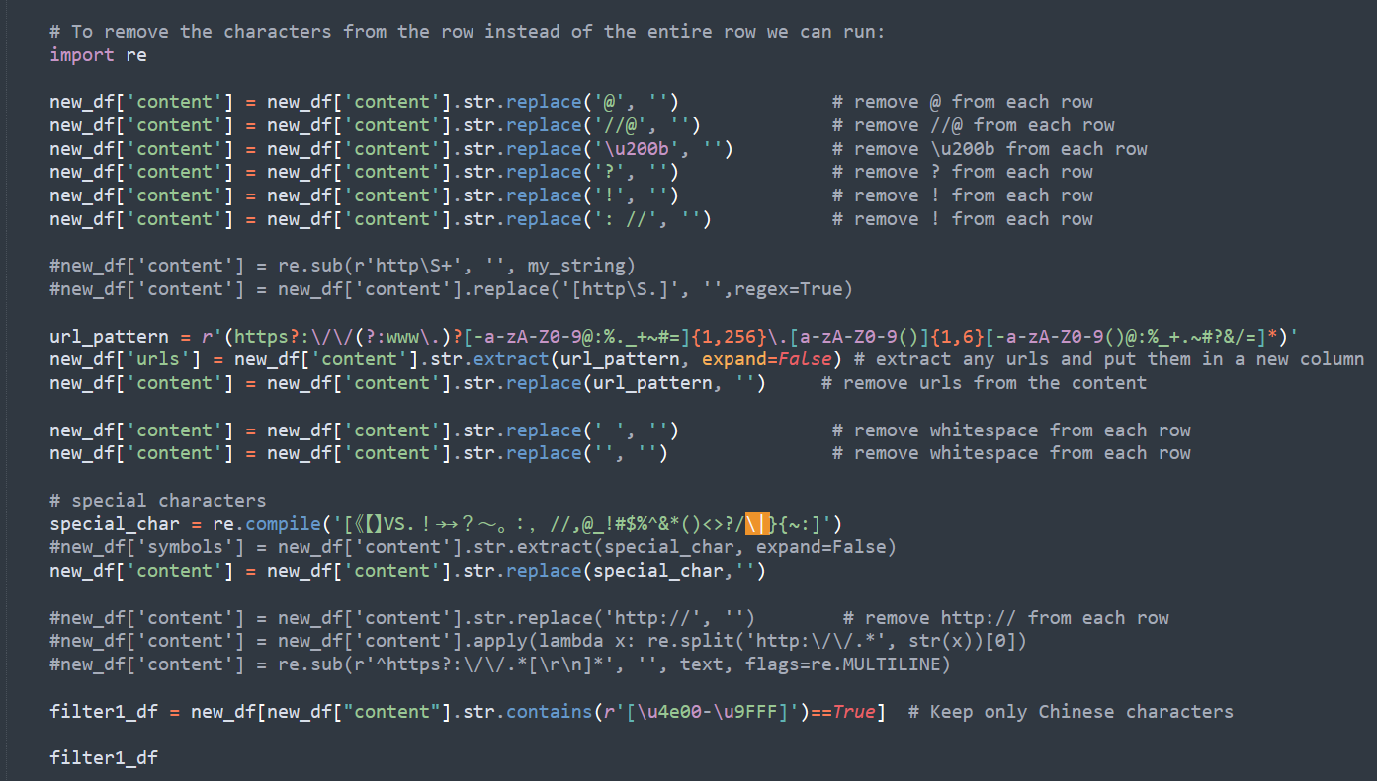
Data cleansing process
1. Remove duplicates.
a. Duplicated data may exist due to reposting from the user. For the purpose of this project, we wanted to remove these duplicates but in future work duplicated posts could be used to try and determine the specific reason a post was censored and how duplicating the post may trigger more intense censors. Hash functions are used here to filter out the duplicates.
2. Removed unwanted characters, such as punctuation, and keywords such as "http", "at' "#", etc..
3. Segment the cleaned data is needed in for the NLP analytic process.

Slide 9
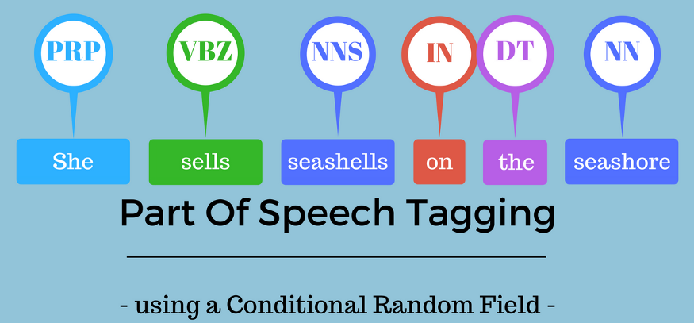
Parts of Speech
What is Parts of Speech?
Parts of Speech is a process tagging a collection of words to a corresponding part of speech, based on the word's context and definition.
Parts of Speech can be used for predictive analysis in Machine Learning.
Example in English: “Give me your answer” this sentence answer is a Noun but, in the sentence, “Answer the question”, answer is a verb.
Example from the project: 水 which means water is a Noun but in a different context can be watery which is a adjective

Slide 10
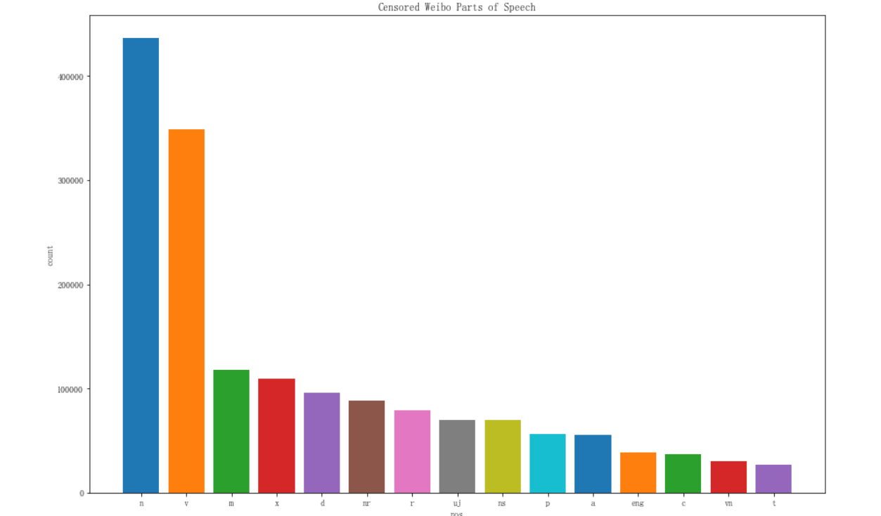
Parts of Speech in our analysis
Count of parts of speech found in our dataset.
Notes:
Show Jupyter code for this chart

Slide 11
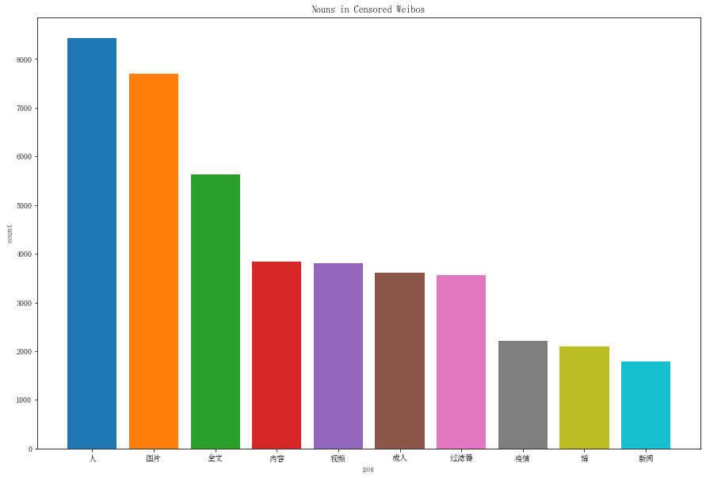
Parts of Speech in our analysis
Count of top 10 nouns found in our dataset
Notes:
Show Jupyter Code for this chart

Slide 12
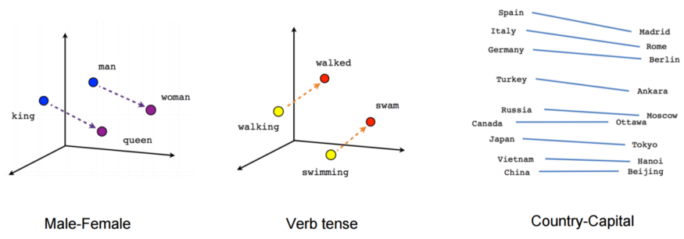
Word Embedding analysis in our dataset
What is Word Embedding?
Word Embedding is a vector representation for a specific word in a sentence. How Word Embedding works is by classifying words based on similar context into vectors and then mathematically calculating the cosine of that angle between the vectors. The closer two words or sentences are to one the more similar the word or sentence is.
Notes:
Show Jupyter code here.

Slide 13
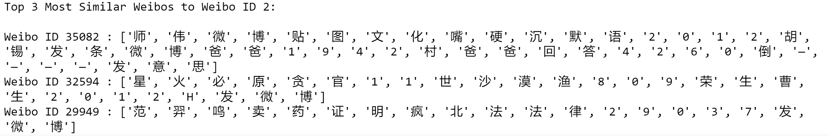
Word Embedding analysis Example
Here is an example. Weibo ID 2. We can identify the top 3 most similar weibos in our entire dataset. The most similar weibo is weibo ID 35082
Weibo ID 35082’s content is as follows: ”你们几个的智商还是别谈政治吧，你们永远是被洗来洗来洗去的主 //@迦南之猫: //@李颖_2015:“志愿”二字是错 //@choyaku:2年前我去首尔旅游,参观战争纪念馆,讲解员告诉我是北朝鲜先发动战争,然后美军仁川登陆,眼看就要统一半岛,结果志愿军武力阻止半岛统一,被中共的洗脑教科书愚弄了十几年,现在总算清” which means Don’t talk about politics with your IQ, you will always be the ones who will be washed and washed //@火南之猫: //@李颖_2015: The word "volunteer" is wrong//@choyaku : I traveled to Seoul 2 years ago and visited the war memorial hall. The guide told me that North Korea launched the war first, and then the U.S. Army landed in Incheon. It was about to unify the peninsula, but the volunteers used force to prevent the reunification of the peninsula. I was fooled ten times by the CCP’s brainwashing textbooks A few years, now it's finally clear
Notes:
Show Jupyter example code

Slide 14
Word Embedding analysis Example Cont.
The similarity between Weibo ID 2 and Weibo ID 35082
Link between Weibo ID 2 that mentions Lawyer Yuan Yulai and Weibo ID 35082 that discusses brainwashed textbooks. Yuan Yulai is a Chinese rights lawyer. Weibo 35082 may be related to the below article “Chinese rights lawyer takes legal action after Hong Kong, Taiwan-published books seized”

Slide 15
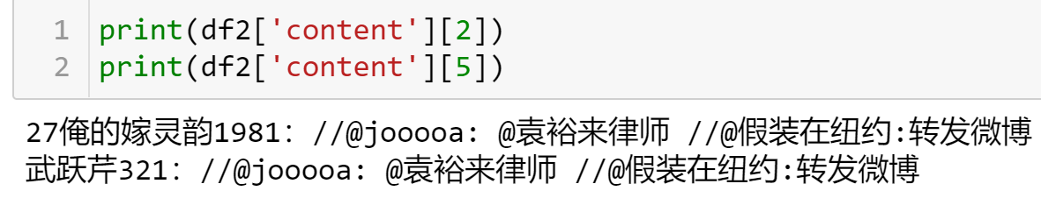
Word Embedding analysis in our dataset
Here is an example. Weibo ID 2 has the text: “袁裕来律师 假装在纽约”, which translate to .” Lawyer Yuan Yulai pretend to be in New York From running our code Weibo 5 is one of the top 3 most similar to Weibo 2 according to the Word Embedding analysis. Weibo 5 has the text: “袁裕来律师 假装在纽约”, which translates to “Lawyer Yuan Li pretend in New York.” According to our code Weibo 5 has a score of 0.96923596

Slide 16
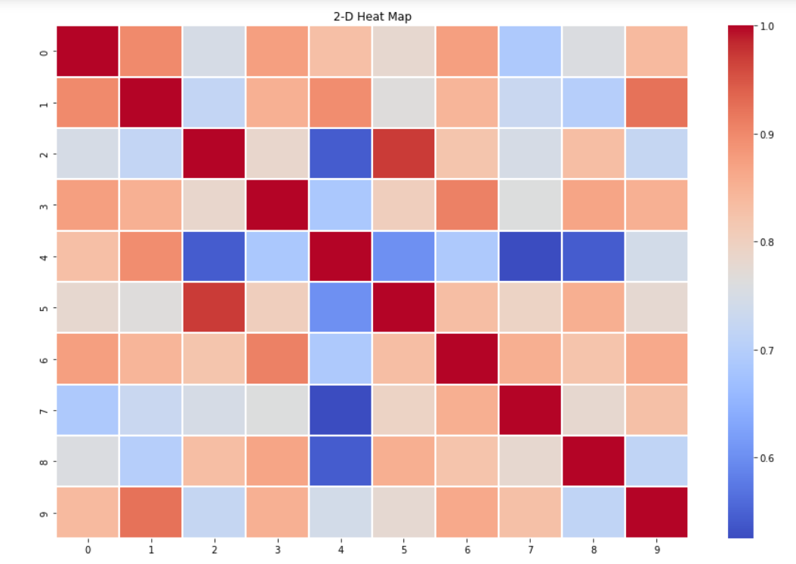
Word Embedding analysis in our dataset
2-D heat map displays the comparison of similar IDs for the first 10 Weibos (ex. Weibo has the most similar match to weibo 5. See next slide for further information)

Slide 17
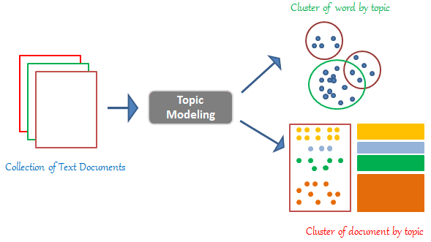
LDA Topic analysis in our dataset
What is LDA Topic Analysis?
LDA Topic Analysis is a topic model that is used to categorize words from a document to a specific topic.

Slide 18
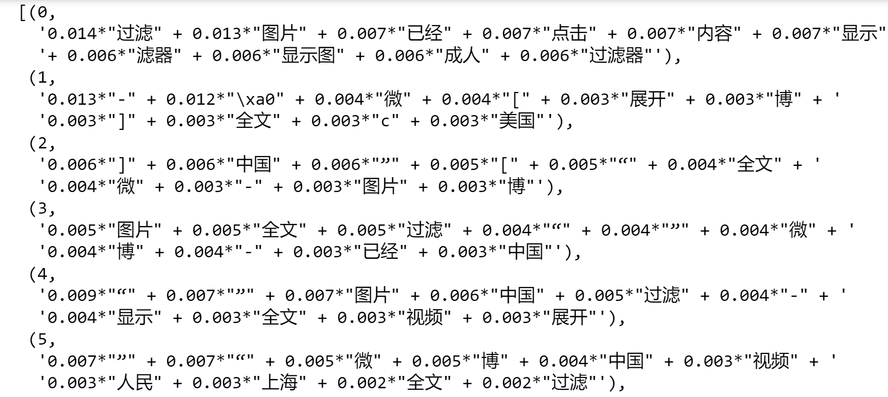
LDA Topic analysis in our dataset
In the example to the right, we see the word “的” this means “filter” in each topic started by the numbers 0-5 we see that that word is scored the highest score showing that it is categorizing this word the most among topics.

Slide 19

LDA Topic analysis in our dataset
This word cloud is generated from word found in our dataset.
[('图 片', 1.0), ('显 示', (picture), 0.9737567248392599), ('滤 器‘ (show), 0.9195643616323317), ('器 滤‘ (filter), 0.9195643616323317), ('国 国‘ (country), 0.8219393780343787)]

Slide 20
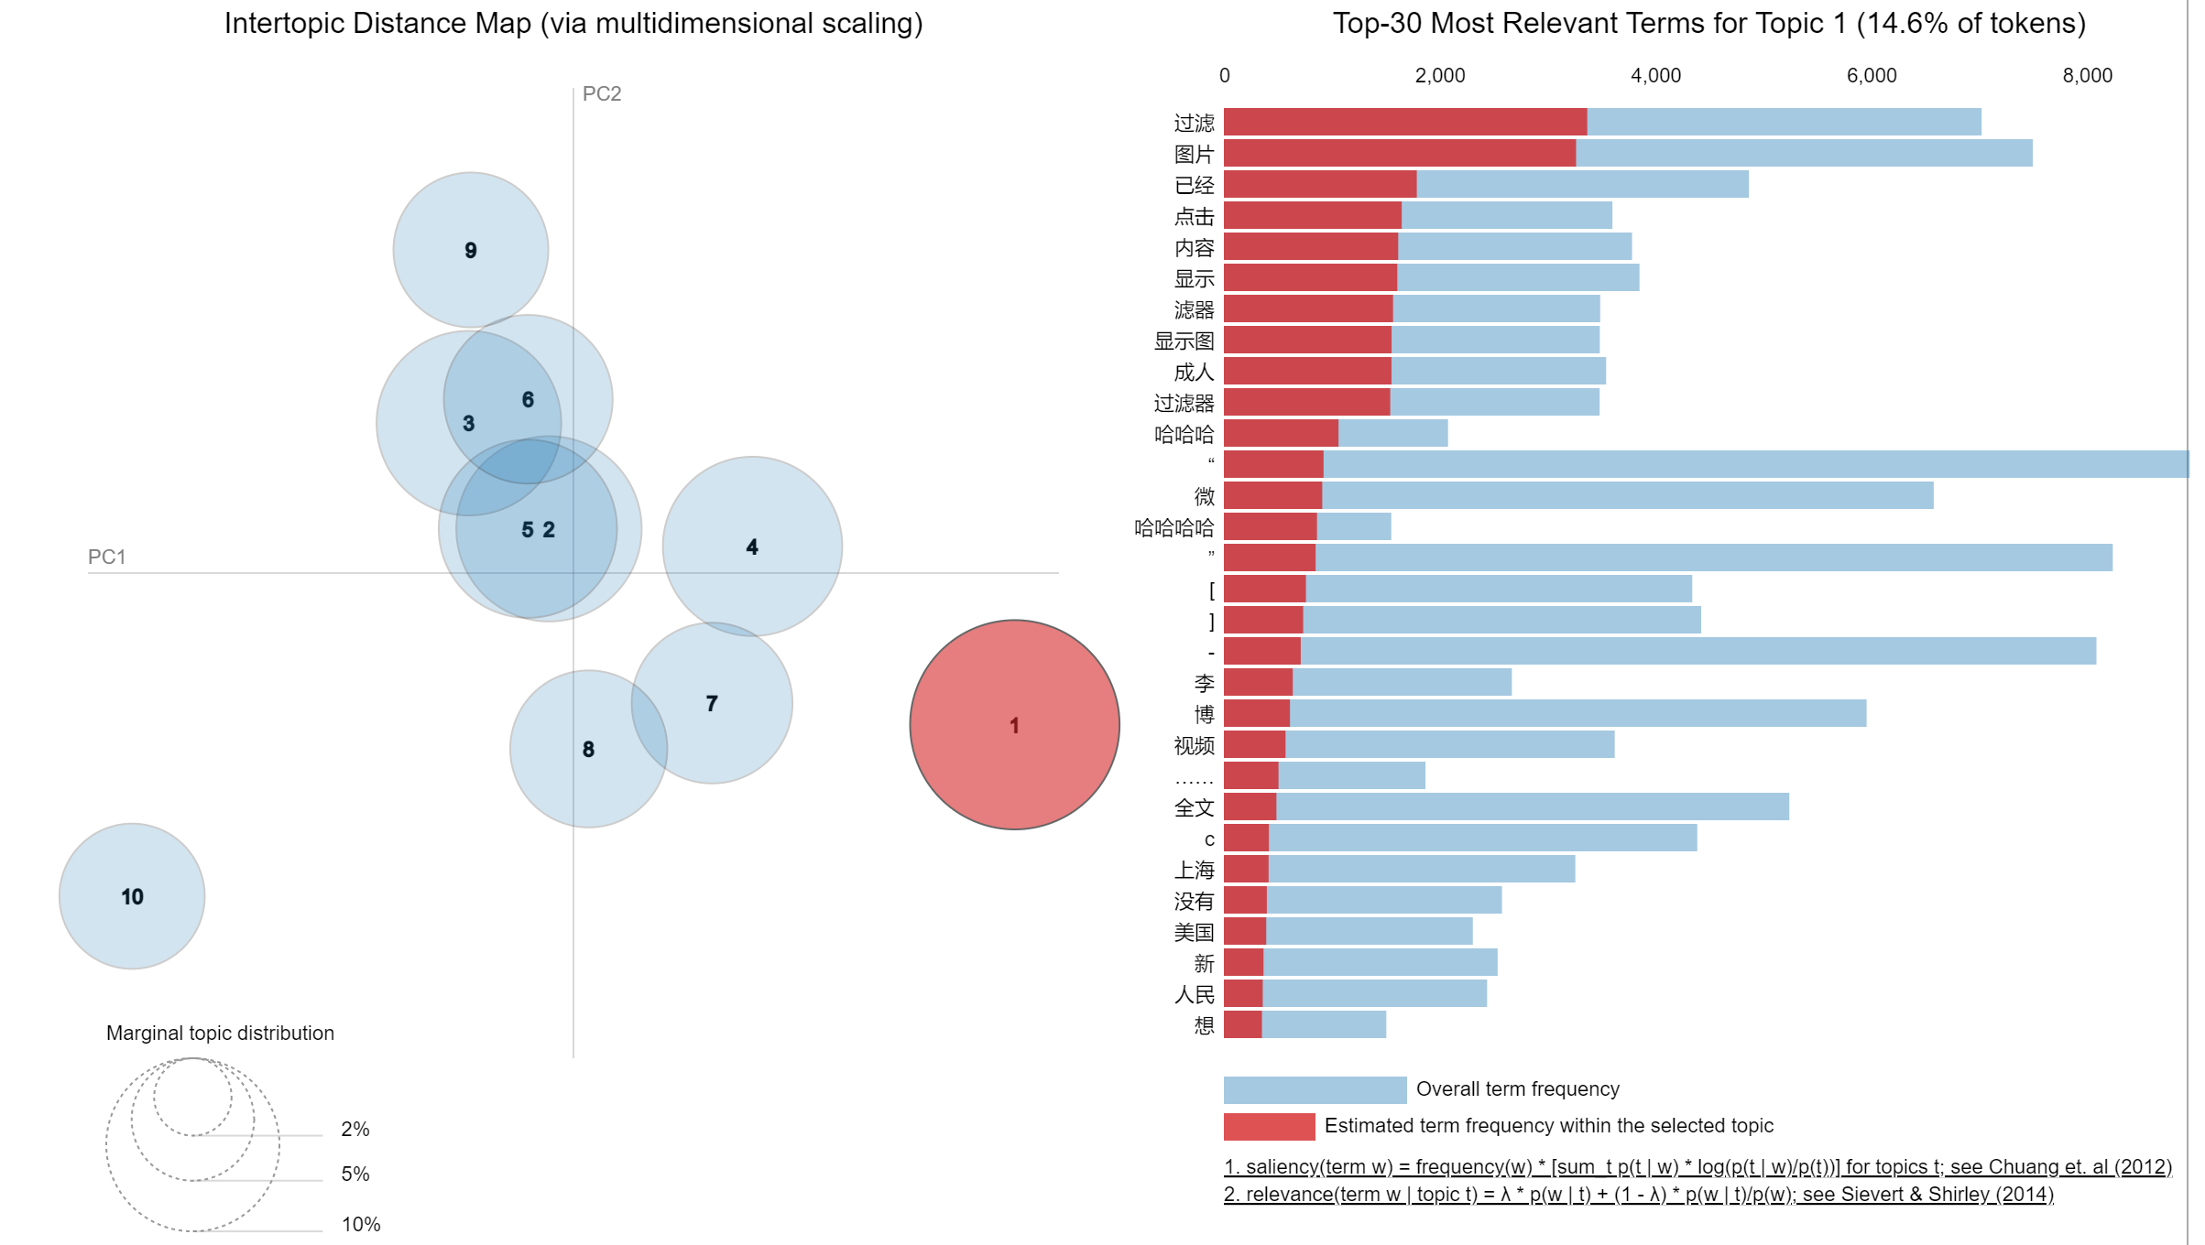
LDA Topic analysis in our dataset
LDAvis is an interactive data visualization tool which allows the user to view which topics overlap and which ones has the most prominent terms in each topic. For topic 1, ‘过滤’ = filter is the most common word
Notes:
Show visualization in Jupyter

Slide 21
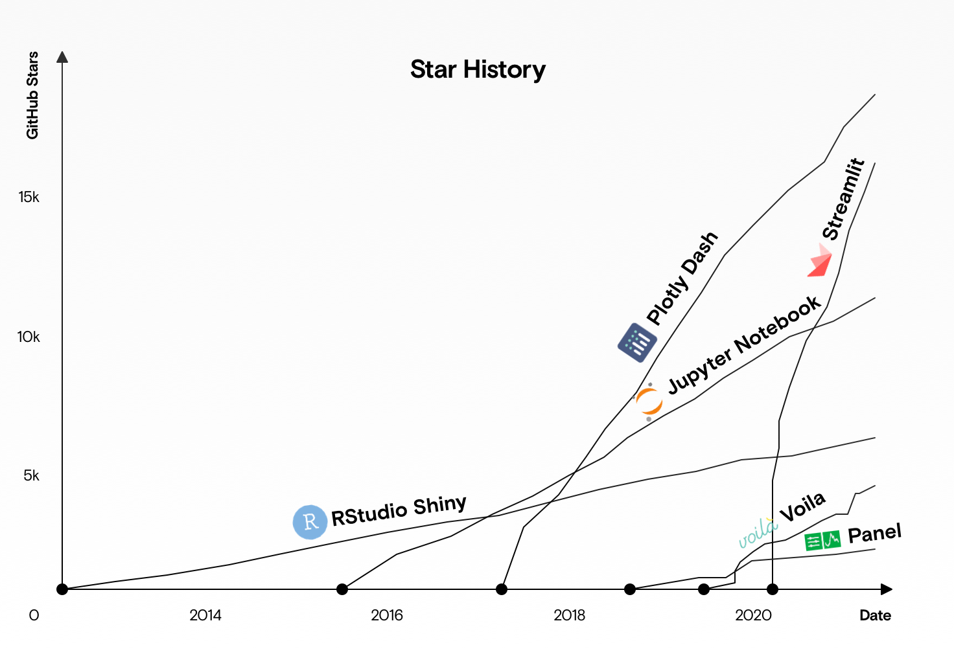
Streamlit vs Django or Flask
What is Streamlit?
Streamlit is free and open-source app built for Machine Learning engineers (This has obviously expanded to anyone looking to built an app using jut python).
The obvious benefits of Streamlit are that you don’t need a program like Django or Flask to bridge the gap between Python and a front-end interface.
Django and Flask are Web Frameworks that allow for more complex web development, but they do not include data visualization, manipulation or any analytical capabilities.
Django and Flask are good options if you have a dedicated engineering team.
Chart from article Streamlit vs. Dash vs. Shiny vs. Voila vs. Flask vs. Jupyter
Notes:
Show visualization in Jupyter

Slide 22

Demo

Slide 23
Body of Work
What were some challenges face?
The biggest challenge was translating some of the python syntax to work with Streamlit
Learning Streamlit in order to best find the right tools to implement for this specific project.
What was accomplished in this project?
Using Streamlit I was able to create an interface where the 3 NLP analytic processes took the data from FreeWeibo and gave us some insight on Censored data on Weibo.
Examples include from the POS tagging Nouns were the most censored types of words and specifically the word 人 meaning people was the most censored noun. This result in the future could be used to determine why it is being triggered and what can be used to bypass it. (As mentioned on next slide in future work)
From Word Embedding we were able to successfully identify similar posts and then visualize them through a 2D heat map.
From LDA Topic Analysis we created an interactive visualization to help see the types of topics that were most discussed in the censored data.

Slide 24
Future Work
What can be drawn from this research in the future?
In tandem POS and Word Embedding can predict words that will follow other words to create a machine learning algorithm and from that apply the word embedding to determine which words are triggering the censor and bypass it by changing those specific words.
For the Word Embedding we can make a robust user interaction where instead of entering the Weibo ID the user can select from a dropdown to select a specific post or other data-point criteria.
With the interface created in Streamlit future work can build off this and use the processing to not just run censored data from Weibo but any data that someone would want to investigate through the three ELP methods.
This data can be investigated further to find other trends regarding censored data on Sina Weibo (Ex. Age of posts).
Optimization of code run-time to incorporate larger dataset.

Slide 25
THANK You
Questions?

